Slide 1
Project-III Presentation
Spring Semester AY 2025-26
NIT
MARL-MAPS
Multi-Agent Reinforcement Learning for
Dynamic Retrieval-Augmented Generation
Supervised by
Dr. XYZ, Assistant Professor, DoCSE, NIT Delhi
Presented By
Name
B.Tech,
Roll No: ____
Department of Computer Science and Engineering
National Institute of Technology, Delhi
May 2026
NIT Delhi

Slide 2
Index
NIT
Introduction
Literature Review
Problem Statement
Motivation
Objective
Proposed Framework
Experimentation And Results
Takeaways and Future Planning
References
NIT Delhi
2

Slide 3
Introduction
NIT
⚡
The Baseline
RAG equips LLMs with verifiable external knowledge to suppress hallucinations and improve factual accuracy.
Query
Agent
📦
First-Gen RAG
🔒
Traditional pipelines relied on static, one-shot retrieval — suffering from context overloading and noisy information.
Monolithic
LLM
Context
Judge
→ Answer
🔧
The MAPS Innovation
MAPS decomposed RAG into specialized agents: Query Extension, Context Judge, Answer Generator — improving modular reasoning.
The Limitation
Answer
Gen
⚠
Despite improvements, MAPS remained constrained by a rigid sequential pipeline with binary pass/fail gatekeeping.
Traditional RAG
Sequential Rigidity
NIT Delhi
3

Slide 4
Introduction (Cont.)
NIT
MARL-MAPS: The Solution
MARL-MAPS Ecosystem
🔀
Dynamic Architecture
MARL replaces the rigid pipeline with a learned Orchestrator — a central RL policy modelling workflow as a Dec-POMDP.
Query
Agent
💰
Confidence as Currency
c=0.87
Agents broadcast calibrated numerical confidence scores instead of binary decisions, enabling nuanced routing.
Answer
Agent
🧠 Orchestrator
(MARL Policy)
c=0.95
🧠
Central Orchestrator
Reads confidence signals to dynamically route workflows and trigger bi-directional negotiations between agents.
Judge
Agent
c=0.42
SGWM
🎯
Global Reward Function
Optimizes for final factual accuracy (EM/F1) while applying progressive penalties for unnecessary retrieval latency.
↔ Bi-directional Negotiation | — Confidence as Currency
NIT Delhi
4

Slide 5
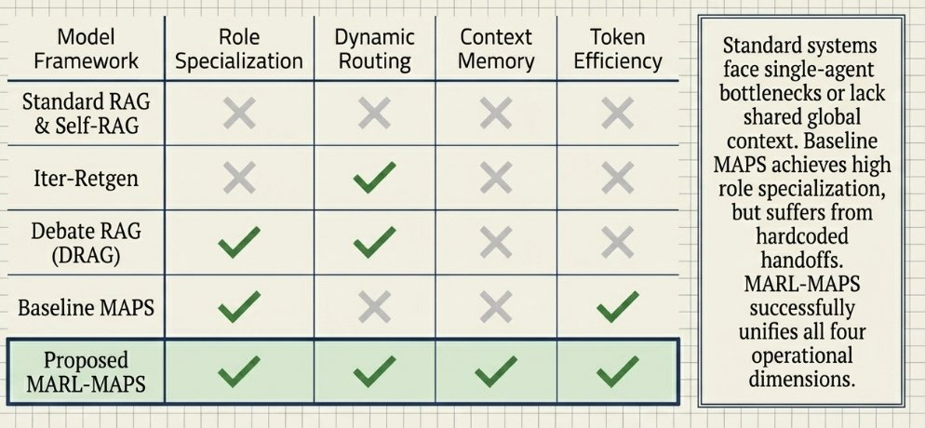
Literature Review
NIT
📄
🔄
🤝
⚙
🚀
Standard
RAG
Iter-Retgen
Debate RAG
(DRAG)
Baseline
MAPS
MARL-MAPS
(Ours)
Single-shot
retrieval
Iterative
loops
Multi-agent
debate
Specialist
agents
Dynamic
orchestration
Key Research Gaps
📌
Context Tax
RAG systems bloat LLM input with noisy documents, spiking latency.
🔒
Binary Gatekeeping
Pass/fail judges lack nuance for partial-match scenarios.
➡
Sequential Rigidity
Hardcoded pipelines block adaptive backtracking.
⚡
No Global Memory
Agents lack shared context, leading to redundant retrievals.
NIT Delhi
5

Slide 6
Problem Statement
NIT
The "Context Tax": Simply appending more retrieved documents into an LLM causes severe latency bottlenecks and increases hallucination risks due to context overloading.
Sequential Rigidity: Foundational multi-agent frameworks like baseline MAPS rely on strict one-way execution pipelines (Query → Judge → Answer) that prevent adaptive backtracking.
Failure of Binary Gates: Current pipelines use rigid "pass/fail" logic for context evaluation, lacking the nuance to handle partial information gaps or conflicting agent signals.
Fatal Error Propagation: A single failure in early steps cascades irreversibly through the static, one-shot pipeline — ruining the final factual accuracy.
NIT Delhi
6

Slide 7
Motivation
NIT
↑ Latency
↓ Nuance
↑ Mistakes
Context
Overload
Binary Gates
Fail
Error
Propagation
Why MARL-MAPS?
Existing RAG systems suffer from inefficiency under noisy or partial context — a fundamental architectural flaw.
Binary gatekeeping by the Judge agent creates a failure mode with no graceful degradation path.
Dynamic orchestration with calibrated confidence scoring offers a principled solution to both rigidity and error propagation.
NIT Delhi
7

Slide 8
Objectives
NIT
01
Dynamic Architecture
02
Confidence as Currency
Transition from a static sequential RAG pipeline to an autonomous MARL Orchestrator.
Implement calibrated confidence scoring for bi-directional agent negotiation and micro-retrievals.
03
Global Optimization
04
Process Efficiency
Formulate a Global Reward Function maximizing factual accuracy (EM/F1) while penalizing latency.
Utilize Hierarchical Process Rewards (HiPRAG) to reduce redundant over-searching behaviors.
NIT Delhi
8

Slide 9
Proposed Framework
NIT
MARL Orchestrator (Critic): Replaces rigid pipelines with a central RL policy that models the workflow as a Dec-POMDP.
Three Specialist Agents: Query Extension, Judge, and Answer — each optimized for a distinct subtask.
Shared Global Working Memory (SGWM): Tracks query embedding, evidence pool, interaction trace, and operational latency to prevent context drift.
Confidence as Currency: Agents broadcast calibrated numerical confidence scores derived via <CN> and <UN> tokens.
Tactical Action Space: The Orchestrator uses confidence scores to route workflows, trigger micro-retrievals, force negotiations, or execute early stops.
Orchestrator
(MARL)
c = 0.87
Query
Agent
SGWM
Answer
Agent
Judge
Agent
"Confidence as Currency"
NIT Delhi
9

Slide 10
Experimentation and Results
NIT
91%
60%
67.2%
5-8k
Over-search
Reduction
GPU VRAM
Reduction
F1 Score
Achieved
Training
Samples
Drastic Over-search Reduction: HiPRAG pruned redundant retrievals — dropping the over-search rate from 27% to just 2.3% (a 91% reduction).
Inference Latency: Dynamic Orchestrator reduced inference time from 2.5–4.0s to 1.8–3.2s by eliminating unnecessary data fetching.
Memory Efficiency: LoRA-based fine-tuning + GRPO parameter sharing cut GPU VRAM requirements by 60%, enabling deployment at scale.
Data Efficiency: Process-level rewards allowed the MARL policy to converge in 5k–8k training samples vs. 90k for naive baselines.
NIT Delhi
10

Slide 11
Takeaways and Future Planning
NIT
✓ Key Takeaways
→ Future Planning
Dynamic Orchestration Works: Learned MARL policy successfully balances high factual accuracy with strict latency requirements.
Confidence > Binary: Calibrated probability scores enable efficient negotiation and surgical micro-retrievals — significantly outperforming binary gates.
Resource Efficiency: Global Reward Function with HiPRAG dropped over-search rate by 91% while boosting F1 accuracy to over 67.2%.
Addressing Non-Stationarity: Future iterations will tackle MARL environment non-stationarity — where one agent's strategy updates force continuous adaptation of thresholds in others.
Training Optimization via SoCo RL: Plan to implement Solo-to-Collaborative RL to reduce the 100–1,000 GPU hours currently required for offline multi-agent training.
NIT Delhi
12

Slide 12
References
NIT
[1] MAPS Foundation: "Multi-agent System with Individual Optimized Expertise for Retrieval Augmented Generation". OpenReview.
[2] MARL Integration: "LLM Collaboration with Multi-Agent Reinforcement Learning". AAAI Publications.
[3] Confidence Mechanisms: "Learning to Route LLMs with Confidence Tokens". ICML.
[4] Process Optimization: "HiPRAG: Hierarchical Process Rewards for Efficient Agentic Retrieval Augmented Generation". arXiv.
[5] Traceability: "Reinforcement Learning for LLM-based Multi-Agent Systems through Orchestration Traces".
NIT Delhi
13

